Slide 1
RC4
VC 210 Recitation Class
Linda Wei
SJTU

Slide 2
Intermolucular force

Slide 3
Classification
Ion-Dipole Ions polar molecules
Dipole-Dipole Polar molecules
London Force All molecules
Ion-diploe interactions:
Cations with (1) higher charge (2) samller radius have stronger
ion-dipole interactions.
London force(色散力): rod-like molecules > spherical shaped moledules, Higher molar mass higher London force

Slide 4
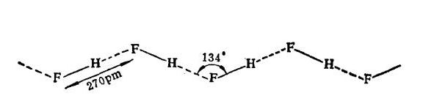
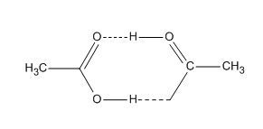
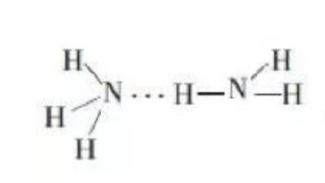
Hydrogen Bond
Atom with high Electronegativity(N,O,F) can form Hydrogen Bond with
H. For example:

Slide 5
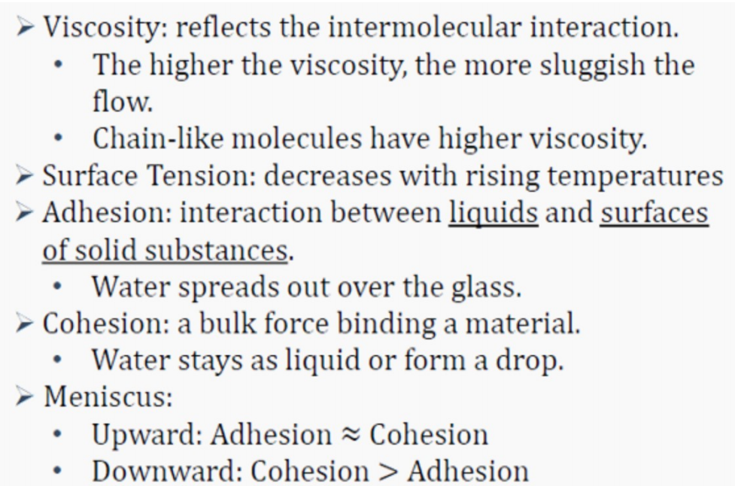
Liquid

Slide 6
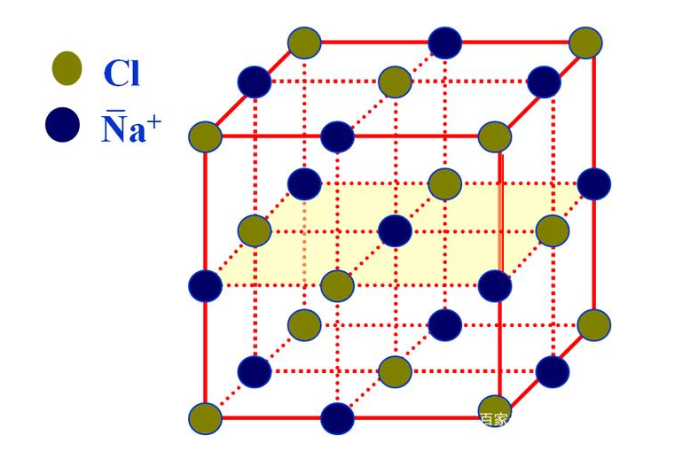
Solid--Crystal
Unit cell: the smallest region the crystal lattice
center:1
corner:1/8
face:1/2
edge:1/4
NaCl:
4 Na⁺,4Cl⁻

Slide 7
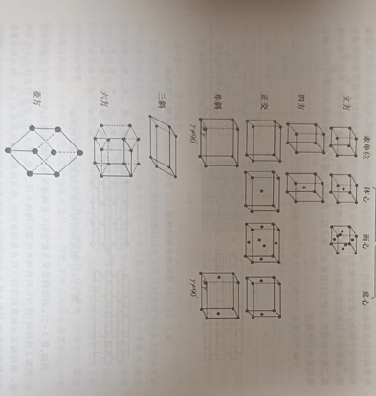
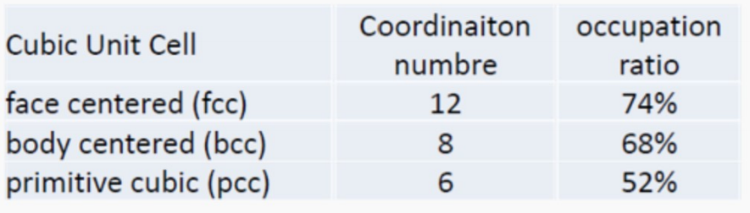
Bravais lattice
There are 14 forms of Bravais lattice in the three dimension lattice
In the general chemistry in JI, we only need to know about the cubic lattice.

Slide 8
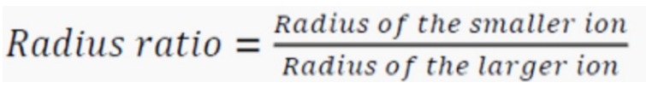
Radius Ratio
radius ratio < 0.414(sqrt2-1): fcc
0.414 (sqrt2-1)< raius ratio < 0.732(sqrt3-1): bcc
radius ratio > 0.732(sqrt3-1): pcc

Slide 9
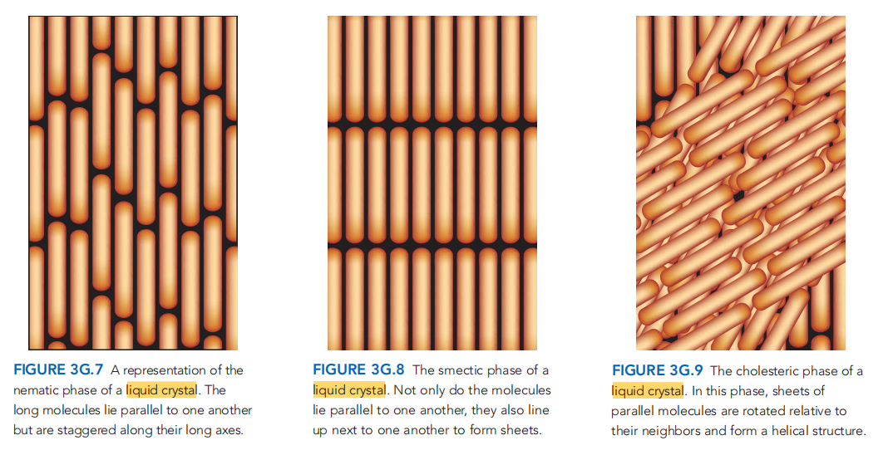
Liquid Crystal
From chemical principle,Knowing about their name and look is enough,copy a draft on your cheating paper.

Slide 10
Thank you

Slide 11
Reference
[1] CHEMICAL PRINCIPLES-THE QUEST FOR INSIGHT
(Seventh Edition)
[2] Wei Xiwen, RC2, VC210 FA2020
[3] Zhou Gongdu, structural chemistry

